Slide 1
Statistical Analysis
Topic: Types of Data and their sources
EQ: What are some differences between the two main types of data and their sources?

Slide 2
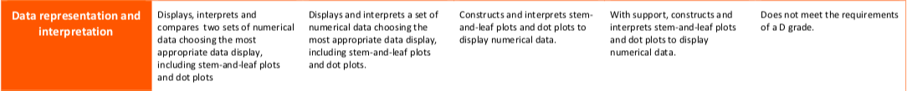
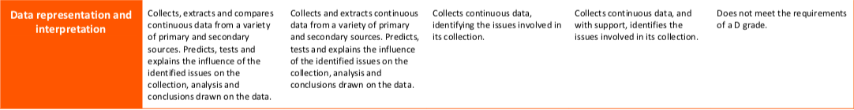

The Judging Standards for this unit (aka - How You will be Assessed!)

Slide 3
Types of Data and Their Sources
EQ: What are some differences between the two main types of data and their sources?
Summary:

Slide 4
Types of Data and Their Sources
EQ: What are some differences between the two main types of data and their sources?
What is Data?
Data are observations or facts
When collected, organised and evaluated, it becomes information
Data can either be:
Categorical
Numerical

Slide 5
Types of Data and Their Sources
EQ: What are some differences between the two main types of data and their sources?
DATA
Categorical
Numerical
This type of data is represented by categories
Example:
Country (Canada, Australia)
Eye Colour (blue, brown)
This type of data is represented by numbers
Example:
Height (2m, 1.4m, 0.9m)
Temperature (23°C)
Number of people in our classroom

Slide 6
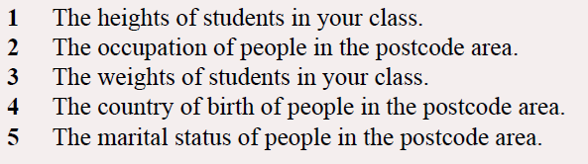

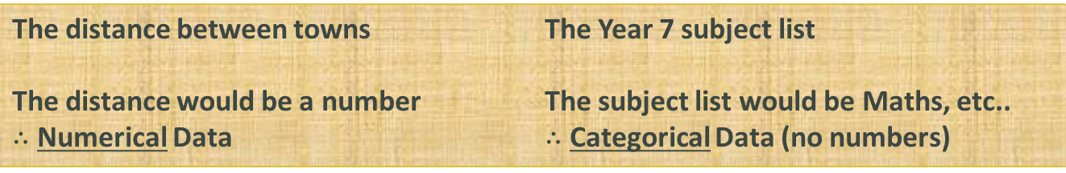
Types of Data and Their Sources
EQ: What are some differences between the two main types of data and their sources?
Examples
The distance between towns The distance would be a number $∴$ Numerical Data | The Year 7 subject list The subject list would be Maths, etc.. $∴$ Categorical Data (no numbers)
Your turn:

Slide 7
Types of Data and Their Sources
EQ: What are some differences between the two main types of data and their sources?
Furthermore, Numerical can be broken down into two sub-types (both still dealing with numbers):
DATA
Numerical
Discrete
Continuous
This type of data is counted
Example:
TVs in the house
Number of people
This type of data is measured
Example:
Weight
Time to run 100m

Slide 8
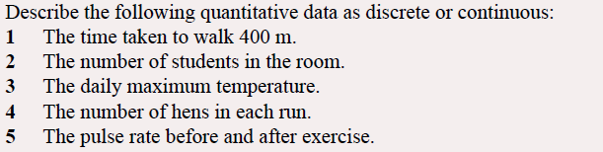
Types of Data and Their Sources
EQ: What are some differences between the two main types of data and their sources?
Examples
numerical

Slide 9
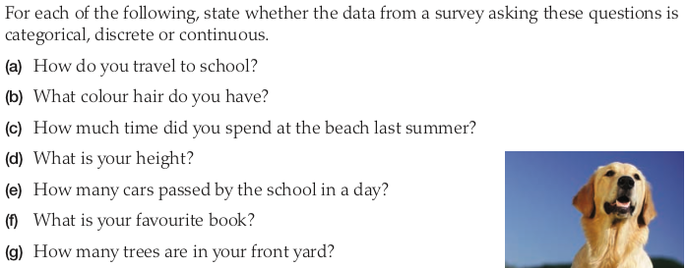
Combined Practice – LHS of INB
Categorical
Categorical
Continuous
Continuous
Discrete
Categorical
Discrete

Slide 10
Types of Data and Their Sources
EQ: What are some differences between the two main types of data and their sources?
What are primary sources??
Original records from the past recorded by people who were:
  Involved in the event
  Witnessed the event, OR
  Knew the persons involved in the event
They can also be objects (artifacts) or visual evidence.
They give you an idea about what people alive at the time saw or thought about the event.
Keep in mind that a primary source reflects only one point of view and may contain a person’s bias (prejudice) toward an event.

Slide 11



Examples of primary sources:
Printed Publications
Books, magazines, newspapers

Slide 12

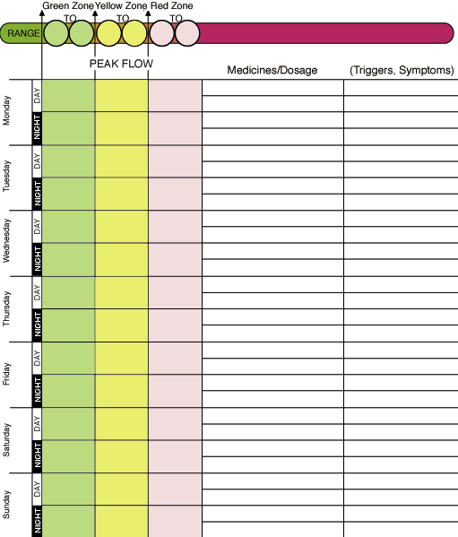

Examples of primary sources:
Personal Records
Diaries, journals, records

Slide 13



Examples of primary sources:
Visual Materials
Paintings, drawings, sculpture

Slide 14

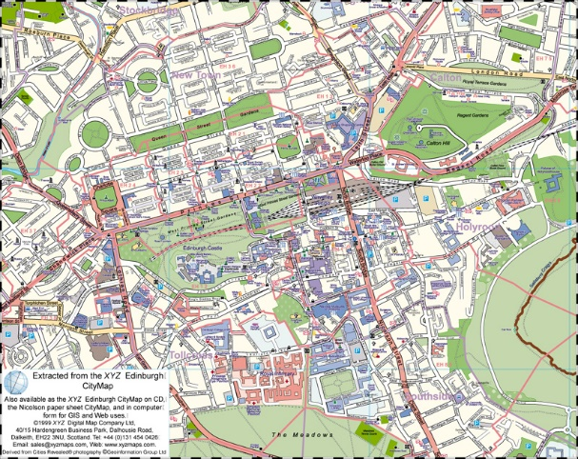

Examples of primary sources:
Visual Materials
photographs, film, maps

Slide 15

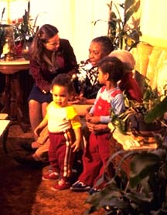
Examples of primary sources:
Oral Histories
Chronicles, memoirs, myths, legends passed down by word of mouth

Slide 16


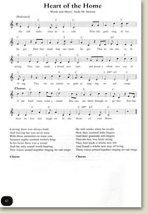
Examples of primary sources:
Songs and Poems

Slide 17
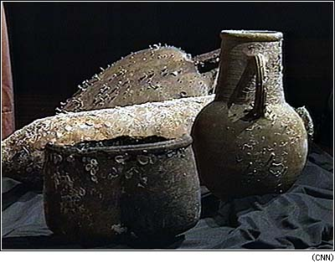
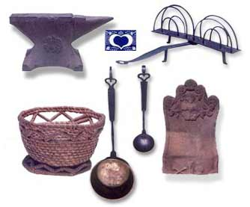
Examples of primary sources:
Artifacts
Tools, ornaments, objects

Slide 18
What are secondary sources?
Secondary sources are made at a later time.
They include written information by historians or others AFTER an event has taken place.
Although they can be useful and reliable, they cannot reflect what people who lived at the time thought or felt about the event.
But they can represent a more fair account of the event because they can include more than one point of view, or may include information that was unavailable at the time of the event.

Slide 19




Examples of secondary sources:
Textbooks, biographies, histories, newspaper report by someone who was not present

Slide 20
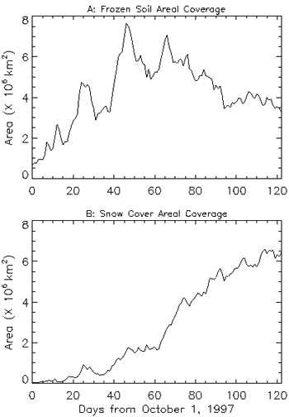
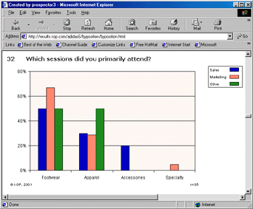

Examples of secondary sources:
Charts, graphs, or images created AFTER the time period.

Slide 21
Primary Vs Secondary Challenge!!
One side of room is Primary and the other side is Secondary. Pick a side of the room you think the answer is.

Slide 22

Source 1
An extract from a news paper written in November 1939…

Slide 23
The answer is…
Primary!

Slide 24

Source 2
A news article written in October 1953 about life in 1939…

Slide 25
The answer is…
Secondary!

Slide 26

Source 3
A TV documentary from 2012 about Hitler’s rise to power…

Slide 27
The answer is…
Secondary!

Slide 28

Source 4
A painting about the war painted in 1943…

Slide 29
The answer is…
Primary!

Slide 30

Source 5
A 1999 panel discussing the impact of the war on Australian industry…

Slide 31
The answer is…
Secondary!

Slide 32

Source 6
Filmed footage of the site of a blitz bombing…

Slide 33
The answer is…
Primary!

Slide 34

Source 7
A letter from a soldier to his wife dated 17th June 1941…

Slide 35
The answer is…
Primary!

Slide 36

Source 9
The 1939 Census…

Slide 37
The answer is…
Primary!

Slide 38

Source 10
A photograph of war veterans taken in 2003…

Slide 39
The answer is…
Secondary!

Slide 40
Types of Data and Their Sources
EQ: What are some differences between the two main types of data and their sources?
Complete your summary by answering the EQ
Summary:

Slide 41
Homework
Review Notes
Primary and Secondary sources worksheet

